Slide 1

Team Members:
Jairo Arreola (jaa0019@uah.edu)
Daniel Burris (dab0021@uah.edu)
Komlan Maglo (kmm0048@uah.edu)
Adam Walters (atw0015@uah.edu)
CPE 495-01 Computer Engineering Design I
Electrical and Computer Engineering
The University of Alabama-Huntsville

Slide 2

Project Summary
Develop an Android App that allows for quick navigation around the UAH Campus.

Slide 3


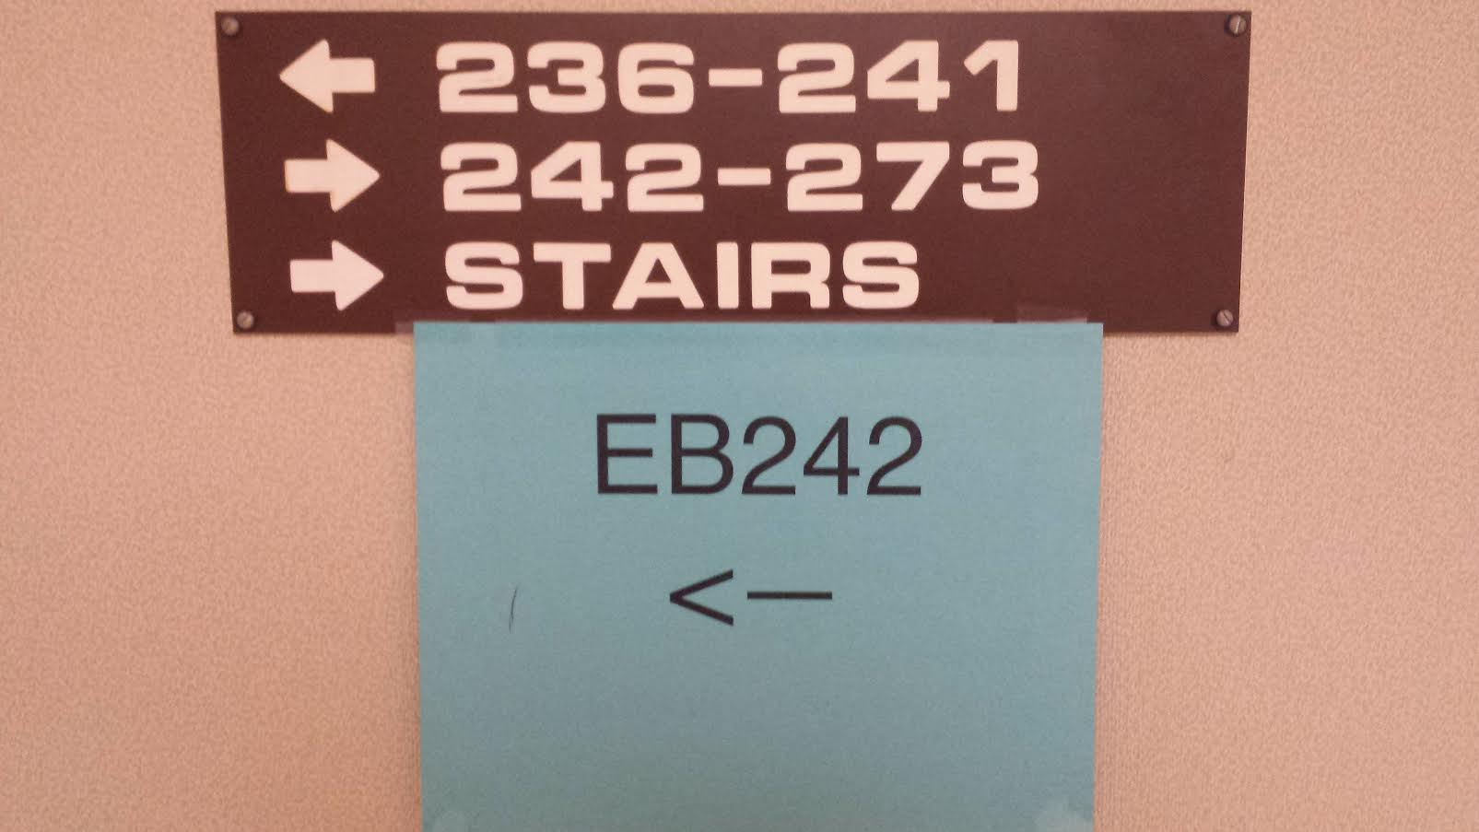
The Need for this Project
Scenario 1
Scenario 2

Slide 4
The Team
Adam Walters - Project Lead. Navigation Lead.
Jairo Arreola - Server Administrator. Utility Programmer.
Daniel Burris - Database Manager. Co-Navigational Assistant.
Komlan Maglo - Graphical Interface Designer.

Slide 5
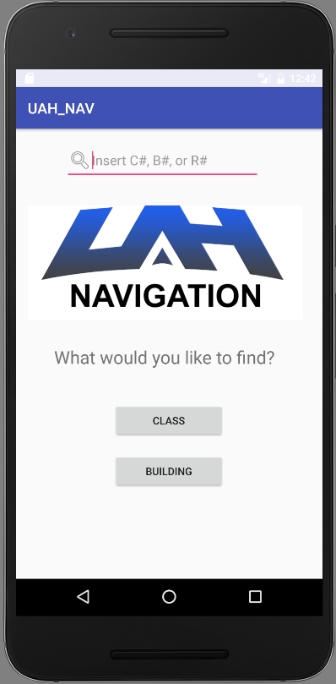
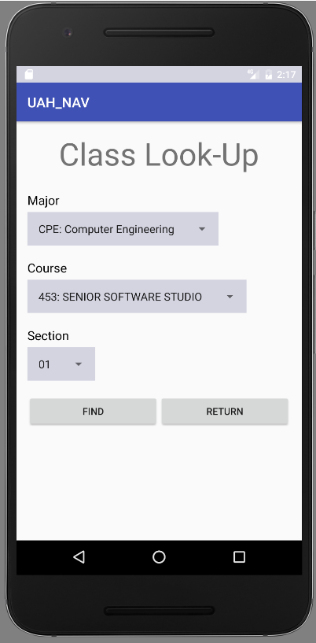
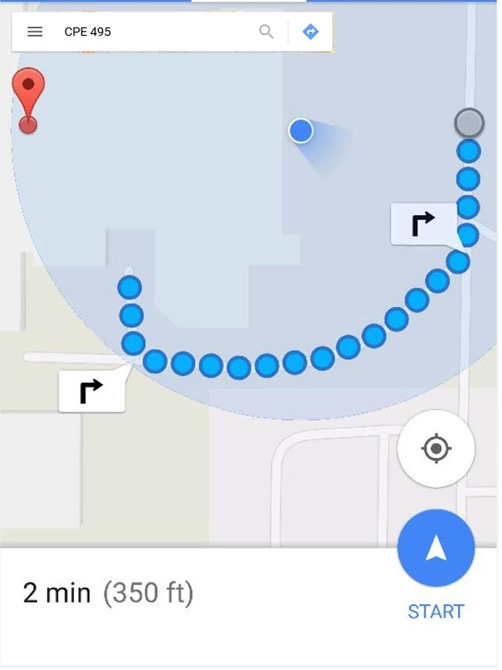
The UAH Navigation App
Time
02:20 pm ▼

Slide 6
Marketing Requirements
Quick Navigation of App’s GUI. (3-Tap Design)
Customers can type in room #, Class #, Building ID, and instantly get directions.
Provides Map of Campus.

Slide 7
Engineering Requirements
GPS Implementation
Database capable of a holding large number of entries.
Easily updatable.
Auto-Fill of Search Query + interactions with drop down menus.

Slide 8
Market & Competition
No direct competition.
Other Navigational Apps do not direct users to specific rooms.
None are specific to the UAH Campus.

Slide 9

Existing Projects
Inactive UAH Building History App.
UAH Events App

Slide 10
Proposed Approach
Interface with Google Maps to handle exterior navigation.
When GPS fails a text-based navigation system will take over.
Store class information in Database for ease of access.

Slide 11
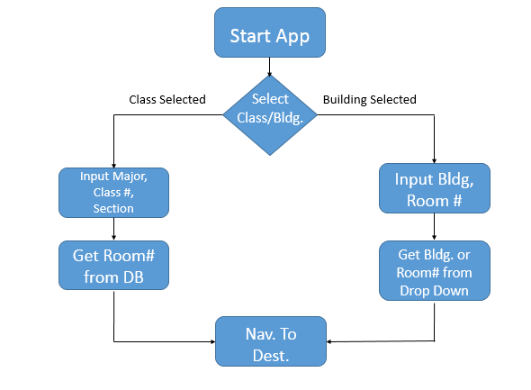
System Design Description

Slide 12
CPE 495 Go/No-Go Milestones
Interfaced with Google Maps to lead users to buildings.
Proof of concept that App can lead to desired classroom.
Created a Test App that can pull info from a database.

Slide 13
Risk Analysis
Ensure stability of database.
Indoor navigation independent of GPS.
Update to keep current with course listings.
Gain access to course listings database.

Slide 14
Analysis of Alternatives
GPS Alternatives
Purely Text-based Navigation.
Pops up Interior Map of Building
Database Alternatives.
SQLite database.
MySQL hosted on RasPi

Slide 15
Test Plan
Test-Driven Development Approach
Unit Tests
GPS
Database
Acceptance Tests
Compatibility on different devices.
GPS Simulation Testing
Location/navigation testing.

Slide 16
Initial Project Deliverables
Deliverable objectives to complete by the end of fall semester
Create an executable app for smartphones.
App interfaces with Google Maps.
App can prepare for indoor navigation.

Slide 17
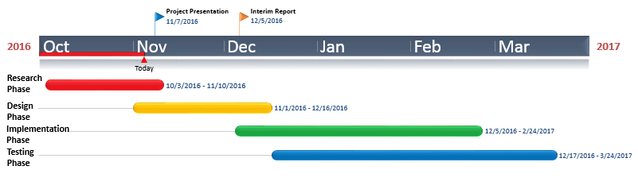
CPE 495/496 Timeline

Slide 18
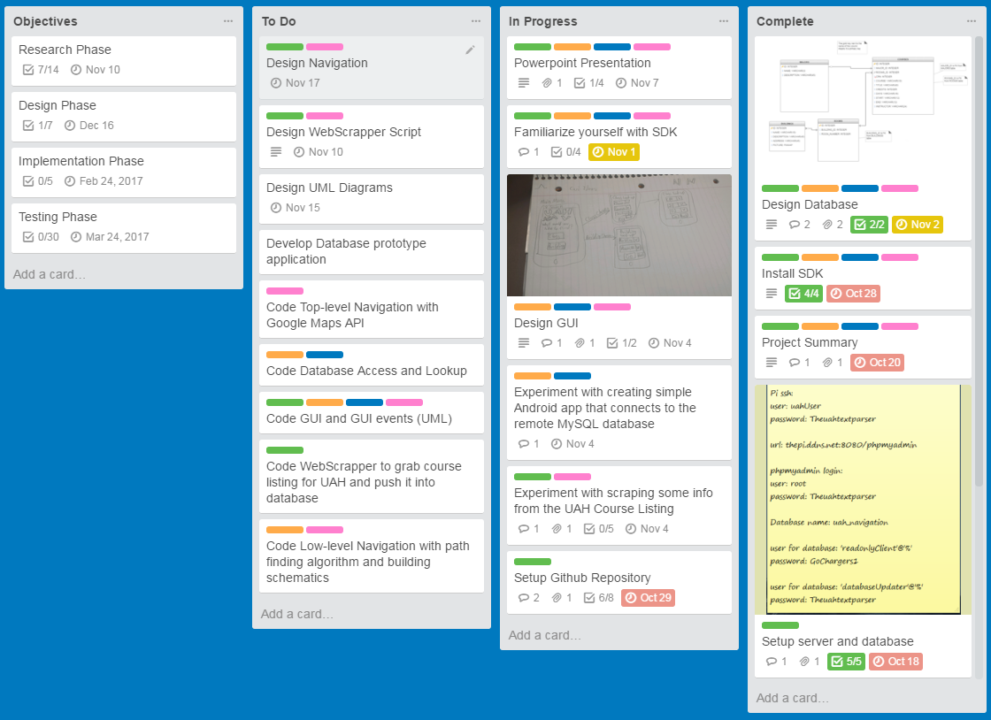
Project Task Manager
https://trello.com/b/iZJ03jLi/app

Slide 19
Cost Estimation
Low Immediate Cost.
Free IDE and Development Kit.
Server Hosting(~$50)
App Store fee (~$25)
Individual Labor Hours = 5 Hours per Week * 23 Weeks * 4 Members = 460 Hours
Meeting Hours = 2 Hours per Day * 2 Days per Week * 23 Weeks = 92 Hours

Slide 20
Final Project Deliverables
Fully functional indoor UAH Navigational App for Android Devices.
Ready to download to most Android Devices.

Slide 21
Stretch Goals
iOS implementation of App.
Implementation of 3D interior maps.
Experiment with GPS Repeater for indoor navigation. (~$200 each)
Implement additional features, i.e. Scheduler, Textbook, Roommate, and Class information.

Slide 22
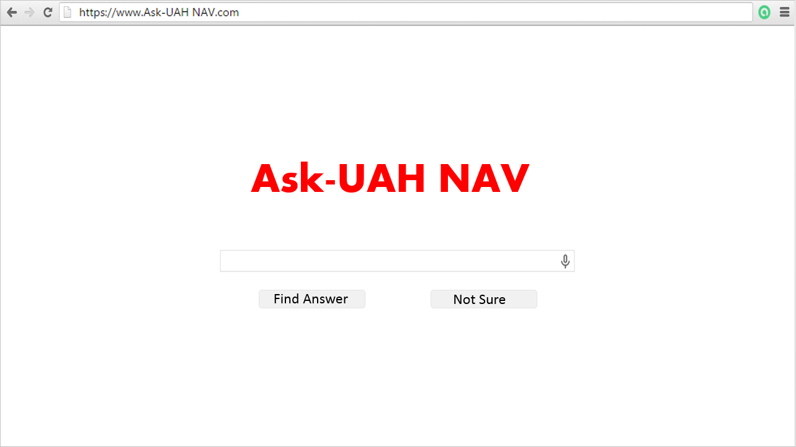
Questions?

